Slide 1
Mind Maps
Mind mapping
a highly effective way of getting information in and out of your brain
a creative and logical means of note-taking and note-making
literally "mapping out" your ideas.

Slide 2
Mind Maps
have a natural organisational structure that radiates from the centre
use lines, symbols, words, colour and images according to simple, brain-friendly concepts
converts a long list of monotonous information into a colourful, memorable and highly organised diagram
works in line with your brain's natural way of doing things

Slide 3
Mind Maps
One simple way to understand a Mind Map is by comparing it to a map of a city:
The city center represents the main idea;
the main roads leading from the center represent the key thoughts in your thinking process;
the secondary roads or branches represent your secondary thoughts, and so on.
Special images or shapes can represent landmarks of interest or particularly relevant ideas.

Slide 4
Mind Maps
The great thing about mind mapping is:
that you can put your ideas down in any order, as soon as they pop into your head.
You are not constrained by thinking in order.
Simply, throw out any and all ideas, then worry about reorganising them later.
So, the mind map is the external mirror of your own thinking facilitated by a powerful graphic process

Slide 5
Mind Maps
The Five Essential Characteristics:
The main idea, subject or focus is crystallized in a central image
The main themes radiate from the central image as 'branches'
The branches comprise a key image or key word drawn or printed on its associated line
Topics of lesser importance are represented as 'twigs' of the relevant branch
The branches form a connected nodal structure

Slide 6
How to Make a Mind Map ?
Think of your general main theme and write that down in the center of the page
Figure out sub-themes of your main concept and draw branches to them from the center, beginning to look like a spider web
Make sure to use very short phrases or even single words
Add images to invoke thought or get the message across better
Try to think of at least two main points for each sub-theme you created and create branches out to those

Slide 7
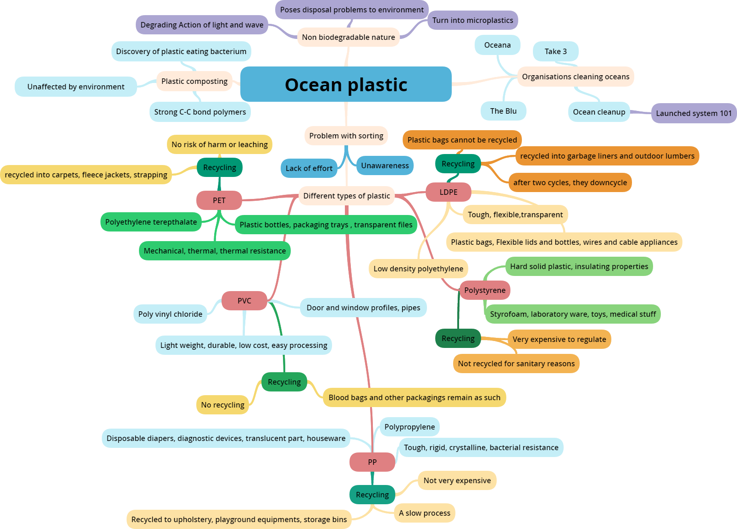

Slide 8
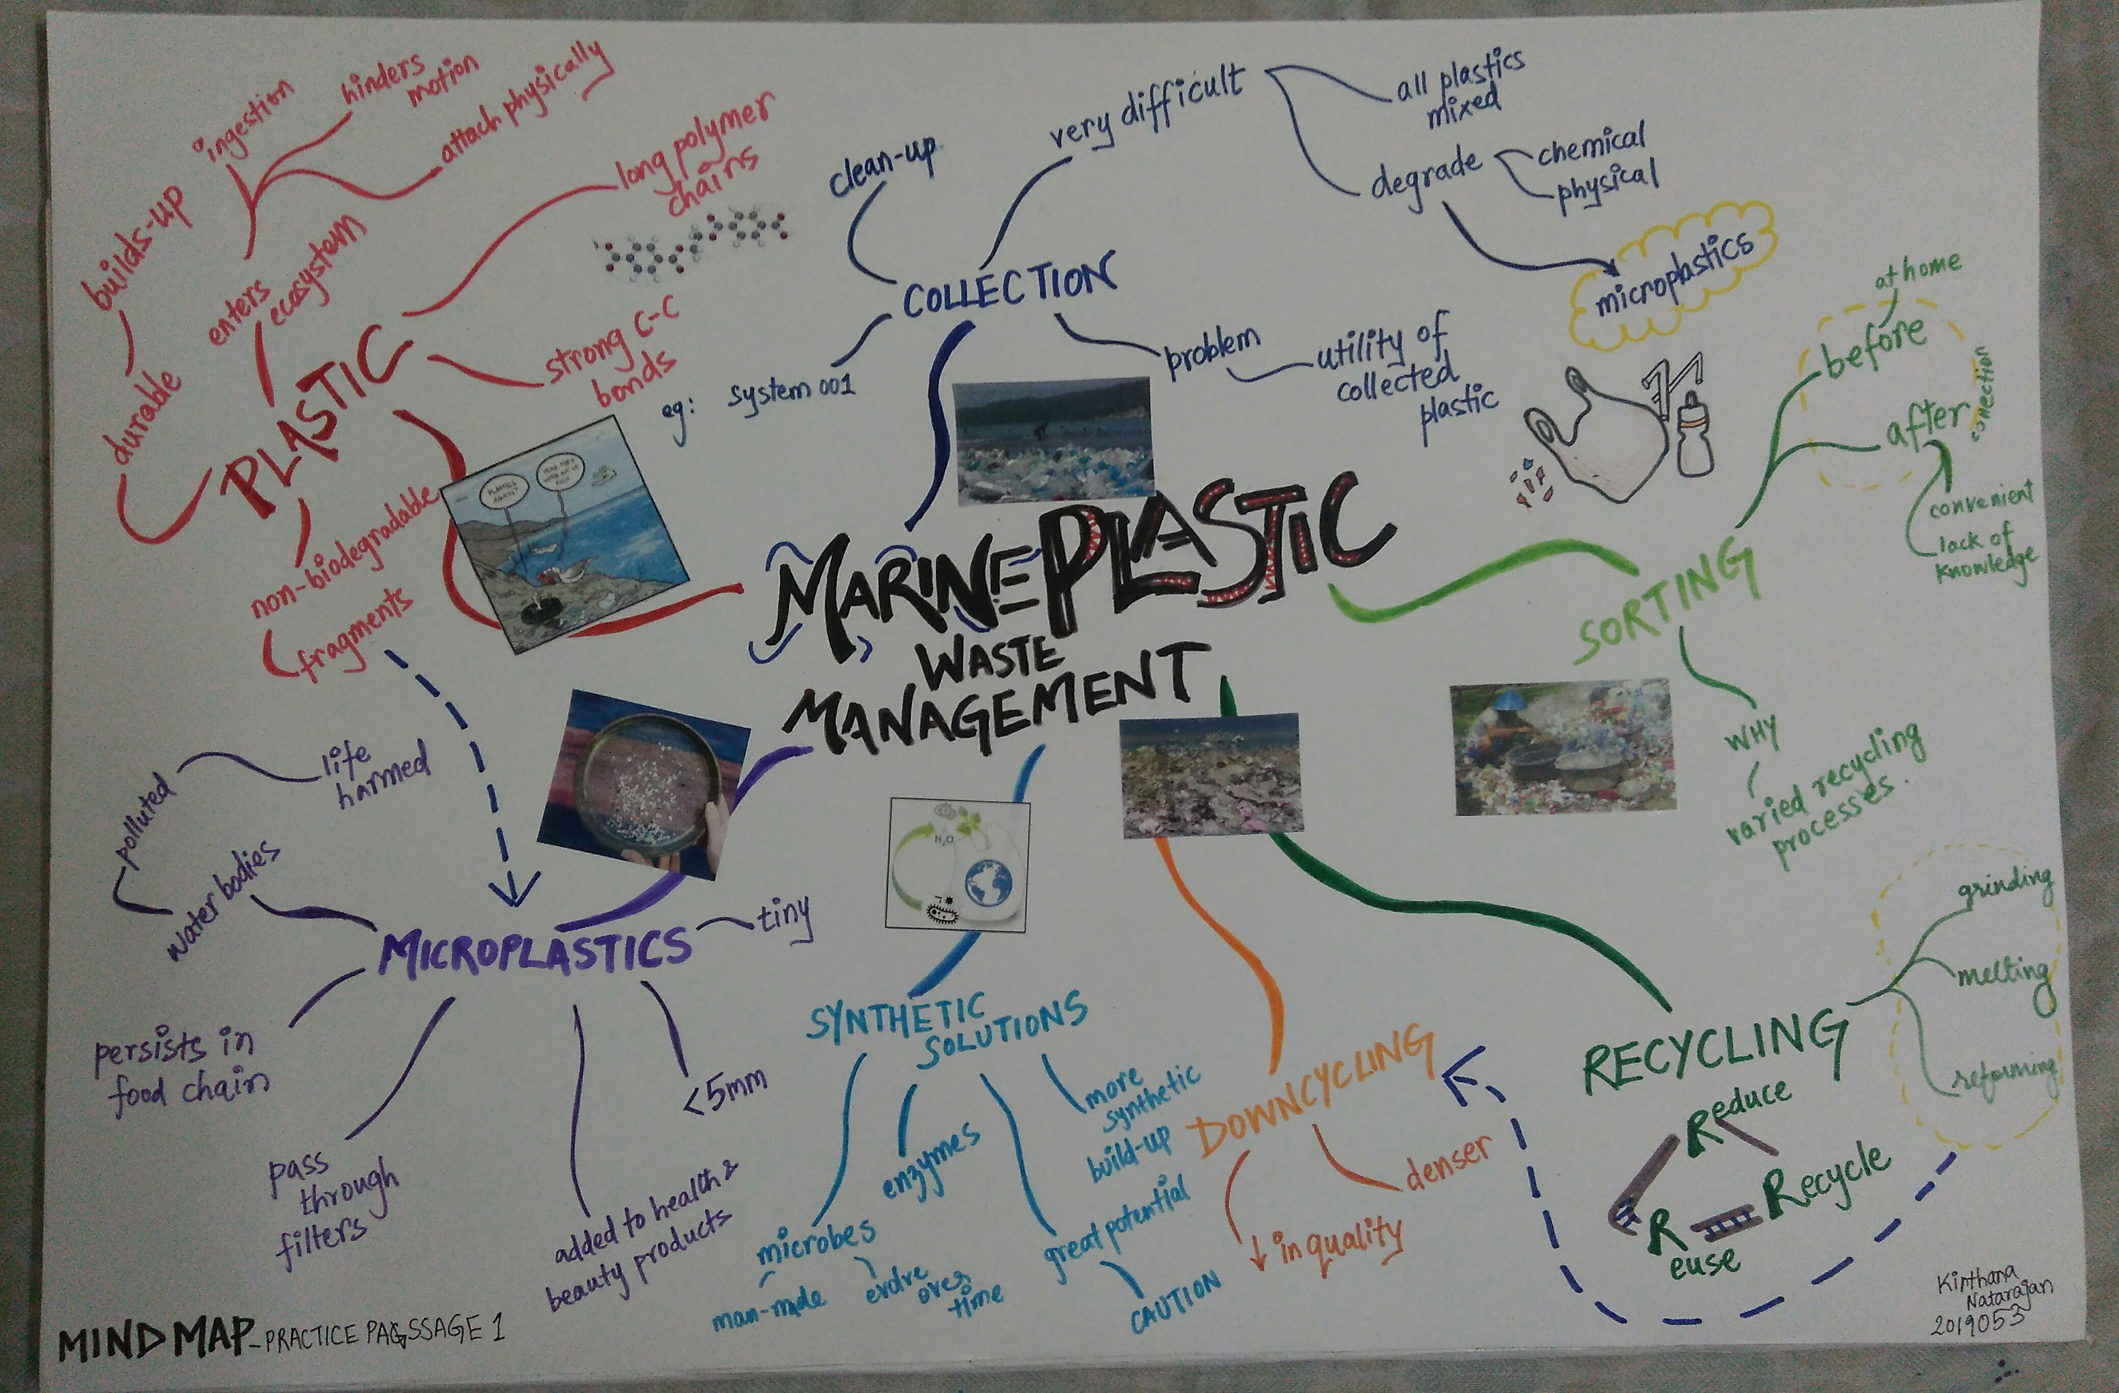

Slide 9
